Slide 1
A* Search

Slide 2
A* Search
A* Search is an algorithm that is widely used for pathfinding and graph traversal.
It finds the optimal path (shortest path) between two points or nodes in a graph.

Slide 3
A* Search
A* Search is type of Best-First Search algorithm.
It uses an evaluation function f(n) for each node.
f(n) provides an estimate for the total cost.
A* expands the node n with smallest f(n).

Slide 4
What is the problem with Dijkstra’s Algoritm?

Slide 5
Dijkstra’s Algorithm
Dijkstra’s is a greedy algorithm (like A*)
It visits too many nodes.
A* search is just like Dijkstra’s with a small difference!!!

Slide 6
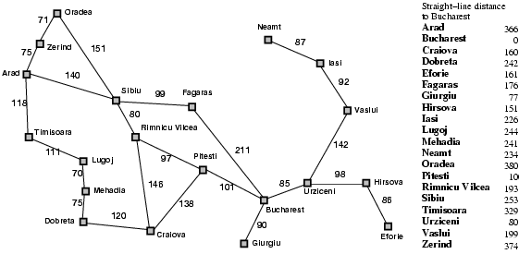
Dijkstra’s Algorithm
Start Node
Goal Node
Traversing too many nodes

Slide 7
Dijkstra’s Algorithm
Dijkstra’s algorithm has one cost function, which is real cost value from source to each node:
f(n)=g(n).

Slide 8
Solution???

Slide 9
IDEA!!!
Use heuristics to guide the search.
Heuristic: estimation of how to search for a solution
Evaluation function f(n) = g(n) + h(n) where
g(n) = cost so far to reach n
h(n) = estimated cost from n to goal
f(n) = estimated total cost of path through n to goal

Slide 10
Dijkstra’s Algorithm
So in summary, for A* Search algorithm:
f(n) = g(n) + h(n)
For Dijkstra’s algorithm, h(n) = 0 which leads to:
f(n) = g(n).
For generic Best-First Search algorithm:
f(n) = h(n).

Slide 11
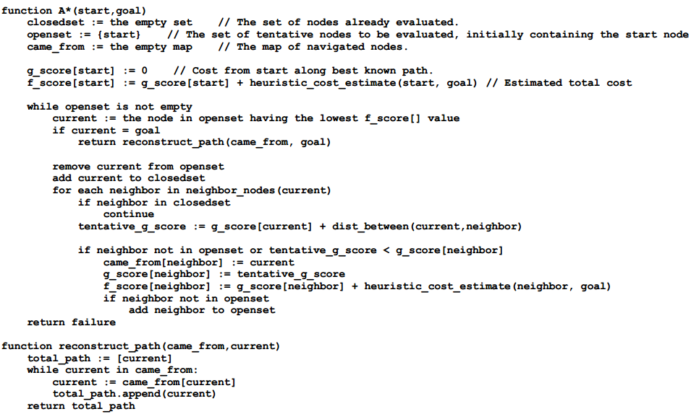
A* Search

Slide 12
A* Search
Start Node
Goal Node
100

Slide 13
A* Search
Zerind: f(n) = g(n) + h(n) = 75 + 374 = 449
Timisoara: f(n) = g(n) + h(n) = 118 + 329 = 447
Sibiu: f(n) = g(n) + h(n) = 140 + 253 = 393
100

Slide 14
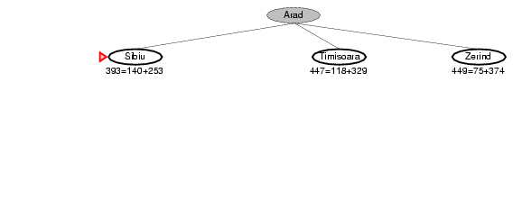
A* Search

Slide 15
A* Search
Fagaras : f(n) = g(n) + h(n) = (140+99) + 176 = 415
Rimnicu Vilcea : f(n) = g(n) + h(n) = (140+80) + 193 = 413
Oradea : f(n) = g(n) + h(n) = (140+151) + 380 = 671
100

Slide 16
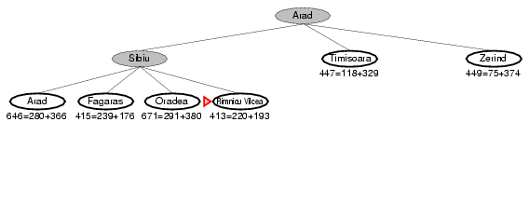
A* Search

Slide 17
A* Search
Fagaras : f(n) = g(n) + h(n) = (140+99) + 176 = 415
Pitesti : f(n) = g(n) + h(n) = (140+80+97) + 100 = 417
100

Slide 18
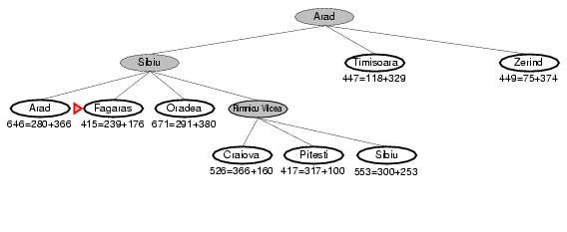
A* Search

Slide 19
A* Search
Fagaras : f(n) = g(n) + h(n) = (140+99) + 176 = 415
Pitesti : f(n) = g(n) + h(n) = (140+80+97) + 100 = 417
Bucharest (via fagaras) : f(n) = g(n) + h(n) = (140+99+211) + 0 = 450
100

Slide 20
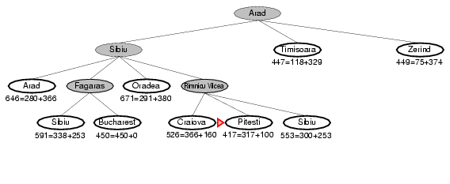
A* Search

Slide 21
A* Search
Fagaras : f(n) = g(n) + h(n) = (140+99) + 176 = 415
Pitesti : f(n) = g(n) + h(n) = (140+80+97) + 100 = 417
Bucharest (via fagaras) : f(n) = g(n) + h(n) = (140+99+211) + 0 = 450
Bucharest (via Pitesti) : f(n) = g(n) + h(n) = (140+80+97+101) + 0 = 418
100

Slide 22
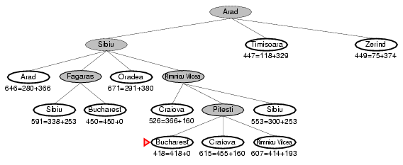
A* Search

Slide 23
A* Search
When h(n) = actual cost to goal
Only nodes in the correct path are expanded
Optimal solution is found
When h(n) < actual cost to goal
Additional nodes are expanded
Optimal solution is found
When h(n) > actual cost to goal
Optimal solution can be overlooked

Slide 24
Dominance
If h₂(n) ≥ h₁(n) for all n (both admissible)
then h₂ dominates h₁
h₂ is better for search: it is guaranteed to expand less or equal number of nodes.

Slide 25
Admissible heuristics
A heuristic h(n) is admissible if for every node n, h(n) ≤ h*(n), where h*(n) is the true cost to reach the goal state from n.
An admissible heuristic never overestimates the cost to reach the goal, i.e., it is optimistic.
If h(n) is admissible, A* using TREE-SEARCH is optimal

Slide 26
Consistent heuristics
h(n) is consistent if for every node n and for every successor node n’ of n:
h(n) ≤ c(n, n’) + h(n’)
h(n)
n
d
c(n,n’)
h(n’)
n’

Slide 27
Consistent heuristics
If h(n) is consistent then h(n) is admissible
Frequently when h(n) is admissible, it is also consistent.
A* generates an optimal solution if h(n) is a consistent heuristic and the search space is a graph.

Slide 28
Performance Analysis
Complete
Yes, unless there are infinitely many nodes
Time
Exponential
The better the heuristic, the better the time
Best case: h is perfect, O(d)
Worst case: h = 0, O(b^{d}) same as BFS
Space
Keeps all nodes in memory and save in case of repetition
This is O(b^{d}) or worse
A* usually runs out of space before it runs out of time
Optimal
Yes, cannot expand f_{i+1} unless f_{i} is finished

Slide 29
THANK YOU!!!

